Slide 1




React – The Functional Way
Marios Simou
Software Engineer
Portfolio: https://www.mariossimou.dev
marios.simou.184
Blog: https://www.blog.mariossimou.dev
@masimou2
MarioSimou

Slide 2
Agenda
Functional Programming (FP)
Definition
Core Principles
Design Patterns
React
Definition
JSX syntax
Components (class-based vs functional)
Stateful vs Stateless components
Communication between components
Code examples

Slide 3
Why should I bother learning FP? ???
Building an application is easy, however, building a good application is damn hard!
Why?
build a good architecture - small, reusable units of code
testing (unit, functional, integration, smoke, non-functional tests)
adding new features with the least amount of changes
multiple developers working on the same repository
performance and acceptable limits
automation and deployment tools (CI/CD)
Functional programming helps to mitigate most of these issues

Slide 4
What is Functional Programming?
Definition:
Is a programming paradigm
Aims to organize our code in functions, with each function to solve a single task
Aggregating those functions should result in a compact application
The result should solve the same problem as any other programming paradigm
FP has its roots in academia and lambda calculus
Function:
Computer Science:
A type that assists programmers to modularize their code
Accepts arguments and may return a result (routines/procedures/methods)
Allows multiple invocations and executions of the same logic
Calculus:
A relation between a dependent and independents variables – y = f(x)
The same input always returns the same output

Slide 5
Core Principles in FP – Pure Functions (1)
Pure vs Impure Functions
Side-effects: any change in the code that is not controlled by the invoked function
Pure: a function independent of side-effects
Impure: a function affected by side effects
Common Side Effects:
Sharing scope with other functions (e.g. global scope)
Any kind of Input/Output (I/O) (e.g. XHR calls, Filesystem access, DB request, DOM etc.)
Mutating objects received as arguments
Calling a function that is already impure

Slide 6
Core Principles in FP – Pure Functions (2)
// global variable
let PI = 3.141519
const calculateArea = (radius) => PI * (radius ** 2)
calculateArea(5) // 78.5379
PI = 3.03 // side-effect
calculateArea(5) // 75.75
Scope: the area within the code that a variable is visible
Functions use scope to access variables when they are invoked. May result on a chain of scopes, including global scope
If multiple functions use global scope to access a variable, a change on the variable will propagate to other functions as well

Slide 7
Core Principles in FP – Pure Functions (3)
// simulates an XHR call - I/O
const fetchResource = (milli, isNetworkConnectionOk) => new Promise((resolve, reject) => {
const cb = () => isNetworkConnectionOk() ? resolve() : reject()
setTimeout(cb, milli)
}) // simulates a network failure
const isNetworkConnectionOk = () => Math.random() < 0.8
;(async () => {
let nSuccesses = 0
const nRetries = 10
for(let retries = 0; retries < nRetries; retries++){
try {
await fetchResource(300, isNetworkConnectionOk)
++nSuccesses
}catch(e){
continue
}
}
console.log('Successes: ', nSuccesses) // 7-9
console.log('Failures: ', nRetries - nSuccesses) // 1-3
})()
When you perform an I/O, its likely to get a response that is outside of the area of your control.
Network bandwidth
The external resource to be irresponsive
Etc.
Aim to isolate this kind of behavior

Slide 8
Core Principles in FP – Pure Functions (4)
const multiplier = (value) => Math.random() * value
multiplier(10) // 8.5415
multiplier(10) // 4.2474
Functions that use impure functions, they inherit the impure behavior

Slide 9
Core Principles in FP – Immutability
const listFruits = (fruits = []) => {
while(fruits.length){
const fruit = fruits.pop()
// Product: orange, Product: banana, Product: apple
console.log('Product: ', fruit)
}
}
const fruits = ['apple', 'banana', 'orange’]
listFruits(fruits)
console.log(fruits) // []
Once a variable is created, you cannot update it. The only option is to recreate it
If the variable is passed by reference, it’s recommended to recreate it when you pass it in a function
Methods that mutate variables should be avoided
e.g. push, pop, splice, shift, unshift and many others

Slide 10
Core Principles in FP – Higher Order Functions
const listFruits = (fruits = []) => {
while(fruits.length){
const fruit = fruits.pop()
// Product: orange, Product: banana, Product: apple
console.log('Product: ', fruit)
}
}
const fruits = ['apple', 'banana', 'orange’]
listFruits(fruits)
console.log(fruits) // []
The language treats functions like any other data type. This means that it can be passed as a variable or even returned from a function

Slide 11
Design Patterns in FP – Closures
const getCounter = () => {
let i = 0;
return () => ++i
}
const counter = getCounter()
counter() // 1
counter() // 2
counter() // 3
const newCounter = getCounter()
counter() // 1
counter() // 2
Any nested function that can access the scope of its parent function.
A function invocation usually creates a scope, meaning that nested functions can access the scope of their already invoked parent functions.
JavaScript manages scopes through Lexical Environments

Slide 12
Design Patterns in FP –Callbacks/Injection
const processData = (e, data) => {
if(e){
console.log('Error: ', e.message)
}
console.log('Processing data: ', data)
}
const fetchData = (number, delay, cb) => {
if(number < 10){
return setTimeout(cb, delay, new Error('The number is lower than 10’))
}
return setTimeout(cb, delay, null, {name: 'foo', email: 'foo@gmail.com'})
}
fetchData(20, 1000, processData) // Processing data: { name: 'foo', email: 'foo@gmail.com’ }
fetchData(5, 1000, processData) // Error: The number is lower than 10
We pass a function as an argument and we expect to execute at some point in time
May execute synchronously or asynchronously
Passing callbacks to a function is the traditional way for executing asynchronous code in JavaScript
This has changed with the introduction of constructs such as Promises and async/await, however, internally they still use callbacks

Slide 13
Design Patterns in FP – Partial Application and Currying
const curry = fn => (...args) => {
if(args.length < fn.length){
return (...other) => curry(fn)(...args, ...other)
}
return fn(...args)
}
const addition = (a,b,c) => a + b + c
const curriedAddition = curry(addition)
curriedAddition(10,20,30) // 60
curriedAddition(10,20)(30) // 60 - Partial Application
curriedAddition(10)(20)(30) // 60 – Currying
const firstStep = curriedAddition(10)
const secondStep = firstStep(20)
secondStep(30) // 60
Rather than passing all the arguments of a function in a single call, we pass them incrementally
Currying is a subset of partial applications, where we pass a single argument at a time
Great way for creating a chain of scopes and preloading functions.

Slide 14
Design Patterns in FP – Recursion
const factorial = (num) => {
// edge case
if(num <= 0){
return undefined
}
// base of recursion
if(num === 1){
return num
}
return num * factorial(num - 1)
}
// Recursion depth: 5
factorial(5) // 120
A function call itself again and again until it meets a condition
Base of recursion is the point in code that recursion returns
When a function calls itself, that’s called a recursion step
Recursion depth is the number of invocations
The functional version of traditional loop

Slide 15
Design Patterns in FP - Others
Thunks/Lazy Loading
delays the evaluation of an expression until its value is needed
Memoization
the technique of introducing a storage unit, which stores values that have already been calculated
Pipelining
executes a sequence of functions, with each function’s output used as the input of the following one. It is moved from left to right.
Composing
similar to pipeline with the exception that it is moved from right to left
Monads
Functors

Slide 16
Advantages and Disadvantages of FP
Advantages:
Easy to maintain and preserve over time
The signature of a function provides all the information a developer needs to understand the logic
Testing becomes much easier
No needs for extended stubbing, mocking since you are writing code with dependency injection in mind (DI)
Less buggy code
Each unit of your application works on its own, without relying on outside effects
Rise of multithread environments since threads are decoupled
Disadvantages:
Steeper learning curve
It includes concepts that developers are not familiar with and may require a bit of time until they grasp them
May introduce performance issues
Immutability suggests the recreation of variables, which also includes more CPU and memory (immutable data structures)
Less intuitive compared to other programming paradigms
A developer is more likely to solve a problem with an OOP rather than a FP approach

Slide 17
What is React?
According to its official website, React is “A JavaScript library for building user interfaces”
Features:
Component-Based
The basic unit of React is a component, which is a container of JSX/JavaScript code
The idea is to split the UI into small, reusable components and then combine them to create the whole application
JSX syntax
HTML-like syntax used to create components
Its not necessary but it makes development more efficient and removes complexity
Declarative
React abstracts away the details on managing the DOM, allowing us to focus on building the UI
Listens on state changes and reacts to them

Slide 18
How it works?
Traditional approach:
Libraries provide utility functions to access the DOM (Document Object Model) and update its content
Changes in the DOM lead to a complete re-render and re-paint of the page
React approach:
React creates a virtual DOM in the background, which keeps track of the changes within the components
It uses an efficient algorithm to compare the actual DOM with the Virtual DOM (diffing)
When there is a change in the state of a component it updates the actual DOM, but only for those nodes related to the change.
Improves performance since it avoids to re-render and re-paint the whole UI

Slide 19
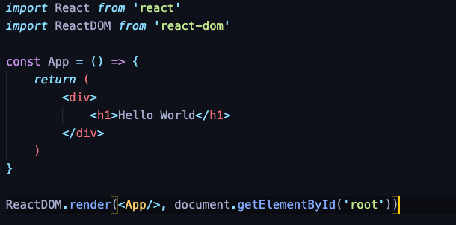
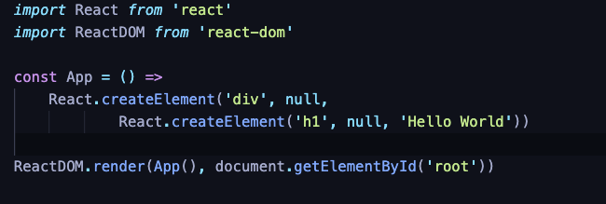
How it looks like?
JSX Syntax
Plain React Syntax

Slide 20
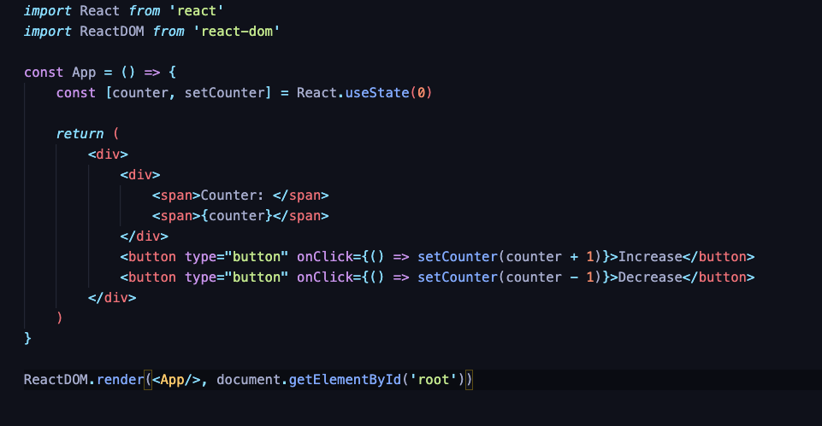
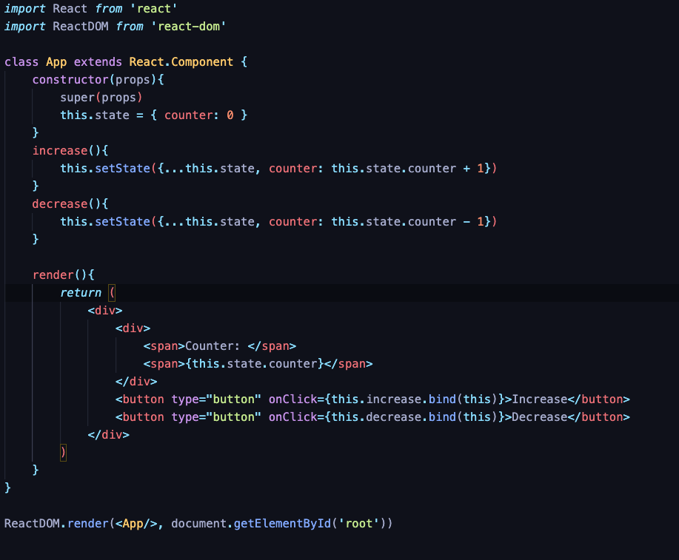
Class-based vs Functional Components
Functional Component
Class-based Component
A component is a function that returns JSX code
Class-based: initialized using ES6 class syntax
Functional: initialized using a function
Prior version16.8, using a class-based component was the only way to handle state
React hooks allowed to Functional components to manage state

Slide 21
Stateful vs Stateless Components
Stateless Component
A stateful component is any component that manages state
A stateless component is any component independent of state
since they don’t handle state, they are pure
Also known as Containers vs Presentational components
Parent nodes tend to manage state and update child nodes (stateless) passing properties to them.
Stateful Component

Slide 22
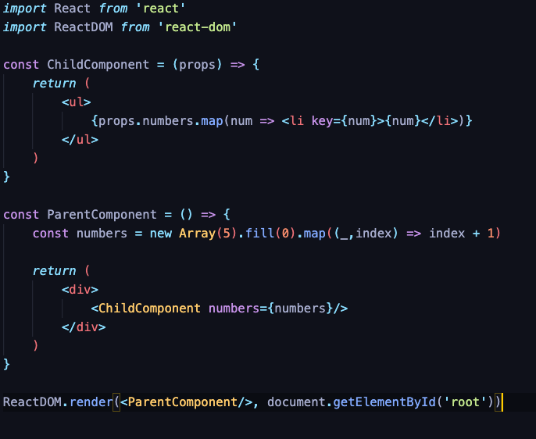
Communication Between Components
A component accepts arguments which are known as properties (props)
We can only pass properties from a parent to a children component.

Slide 23
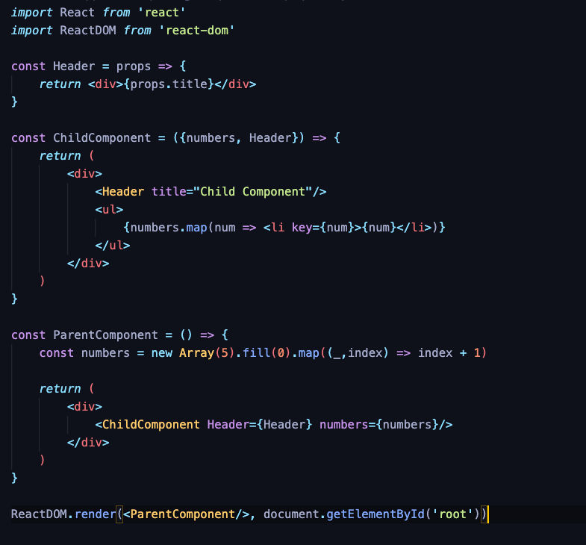
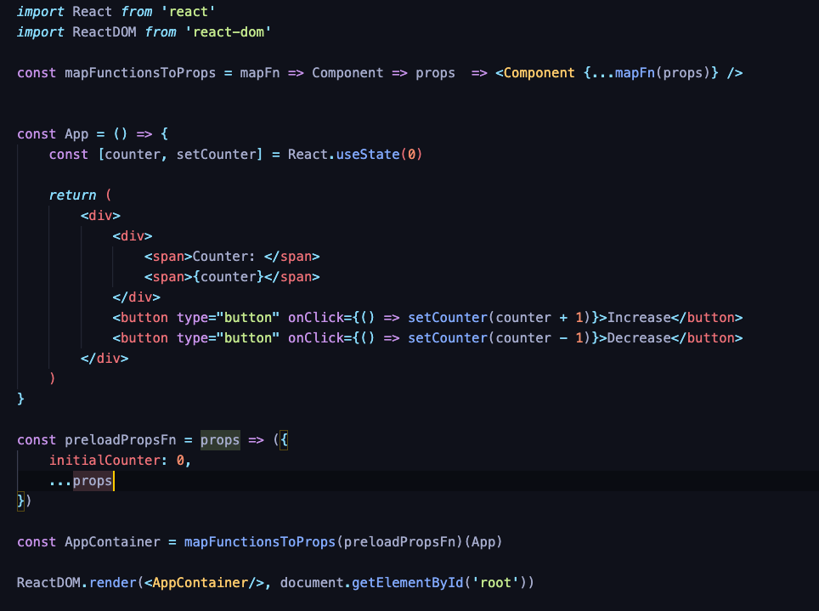
Passing Components as Properties
A parent component may pass a component as prop to its child element
These type of components are called Higher Order Components (HOC)

Slide 24
Recap
A React component is a function that accepts properties (arguments)
The properties may be of any type, including Functions/Components (HOC)
Components that don’t manage state are pure
Passing all the dependencies of a component as properties, we make it pure and easily testable
Most side-effects will be pushed outside the component and can be tested separately
The idea of a component returning a component it’s similar of a function returning a function (closure)

